Slide 1
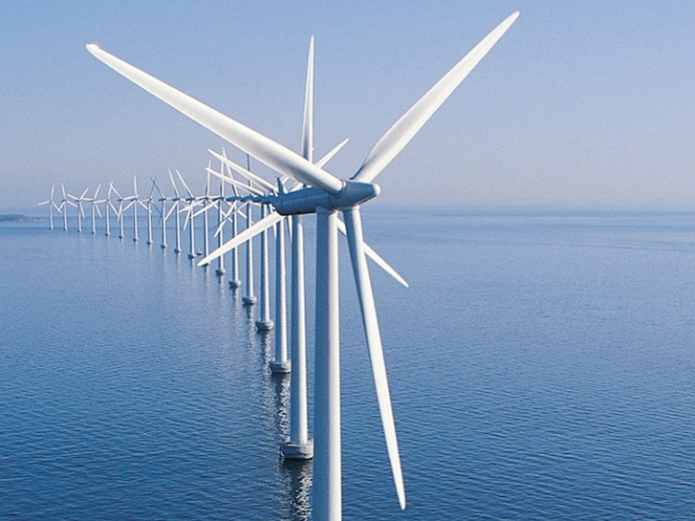
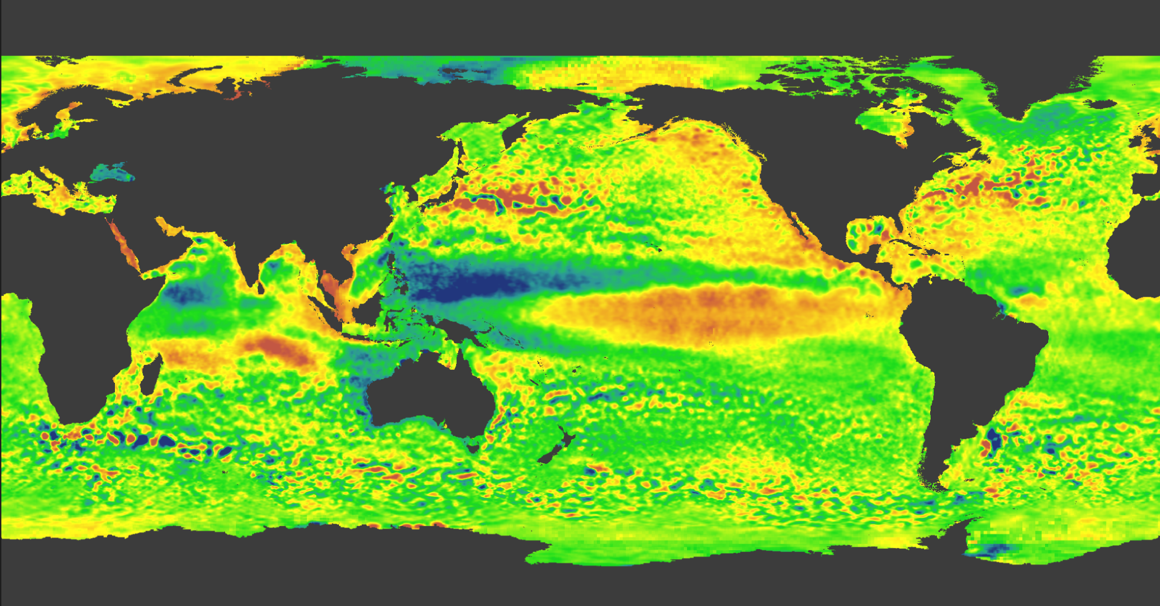
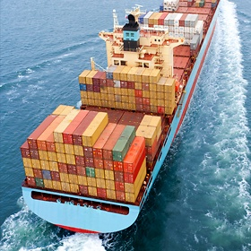
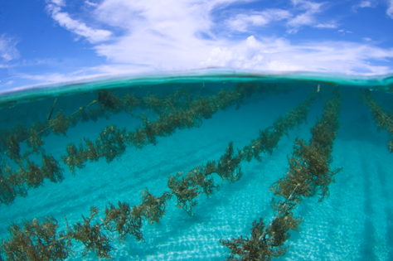
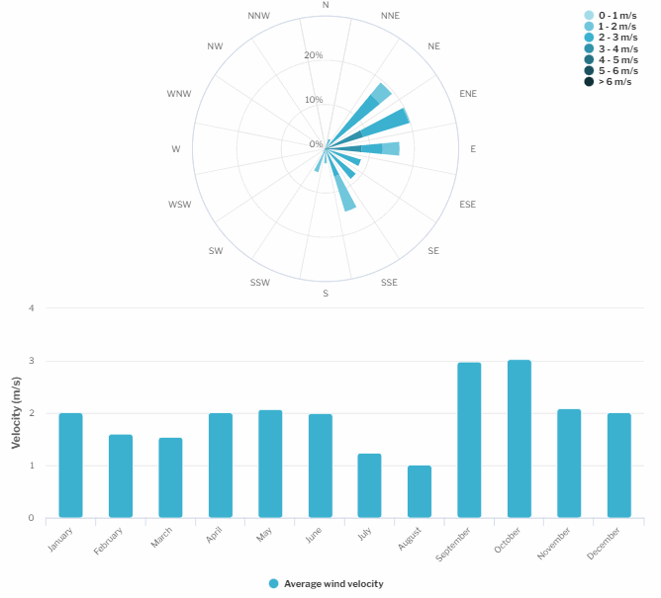
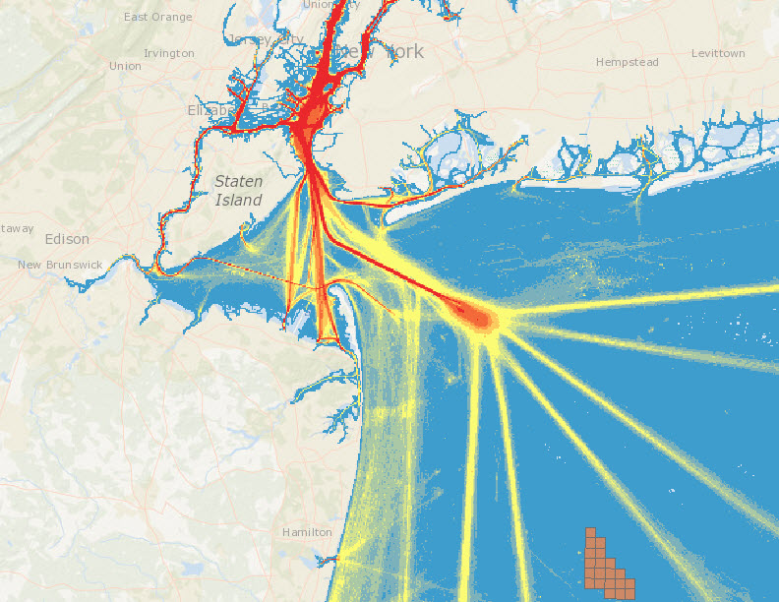

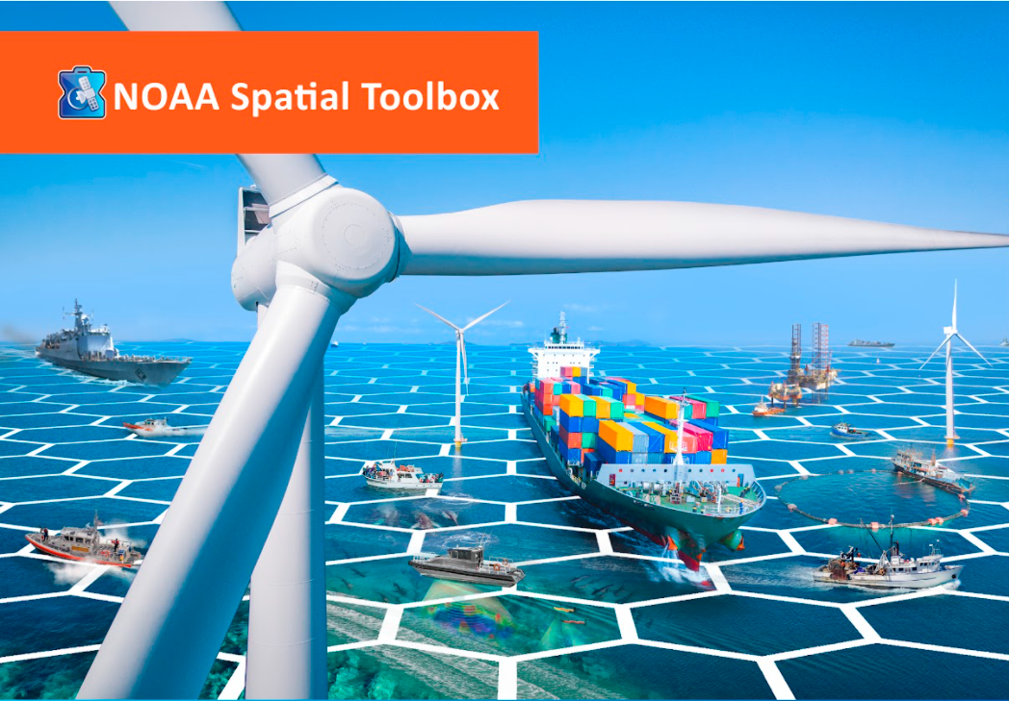

Gulf of Maine Cable Routing - Stellwagen Bank
NOAA OSW Spatial Team
James.Morris@noaa.gov

Slide 2
Agenda
Introductions
Project Timelines
Data Inventory Review
Additional Data/Information from NMS
Cable Routing Modeling Example (How it works)
Discuss ideas for cable routing modeling through Stellwagen NMS
Next Steps

Slide 3
Gulf of Maine Tentative Timelines (Subject to change)
Region | Wind Energy Area | Lease Sale Area | Cable Routing
Gulf of Maine | Draft: Oct. ‘23 Final: Mar. ‘24 | April 2024 | August 2024

Slide 4
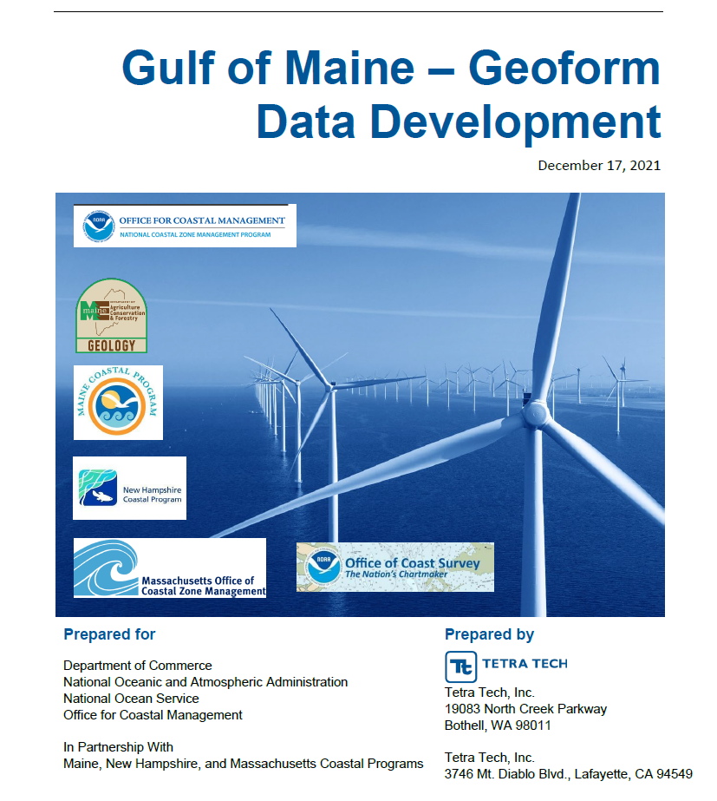
GOME Data Inventory (Focusing on Stellwagen NMS)
NE Ocean Data Portal Data
Bathymetry (8-m Resolution)
Coastal and Marine Ecological Classification Standard (CMECS) for seafloor

Slide 5
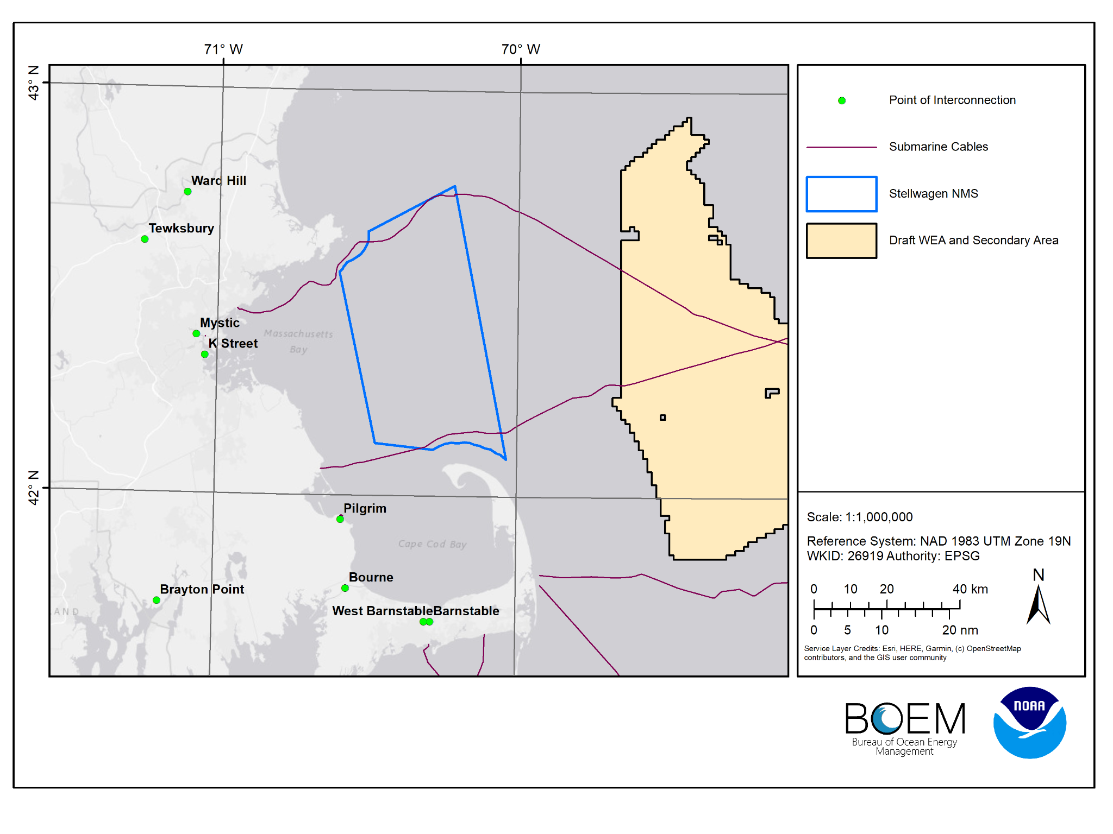
Existing Submarine Cables
-North cable is an active fiber optic cable
-South cable is an inactive telegraph cable

Slide 6
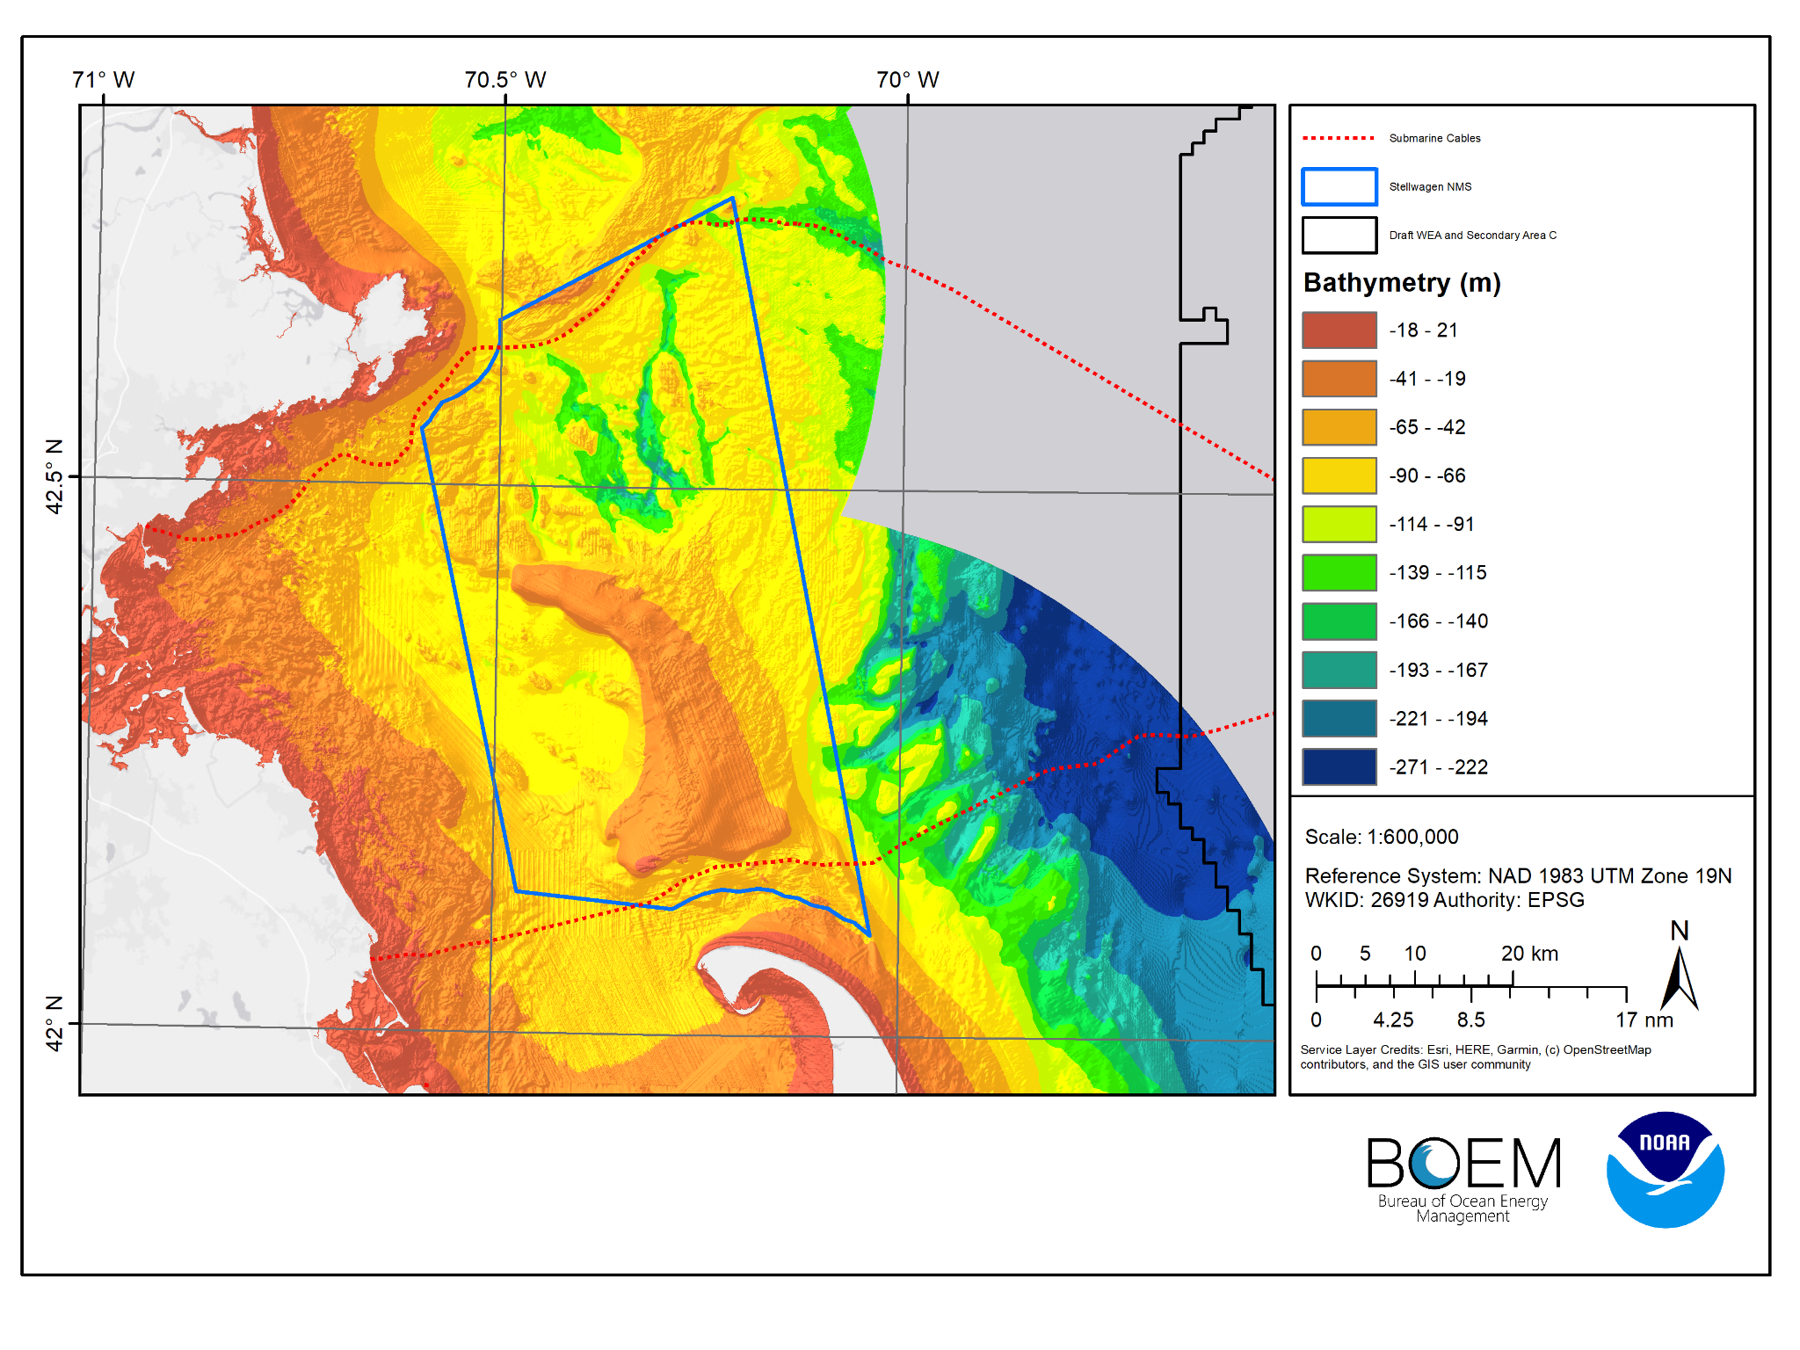
Bathymetry Data
8 m resolution - GOM21
Other data sets exist - is there a preferred one?

Slide 7
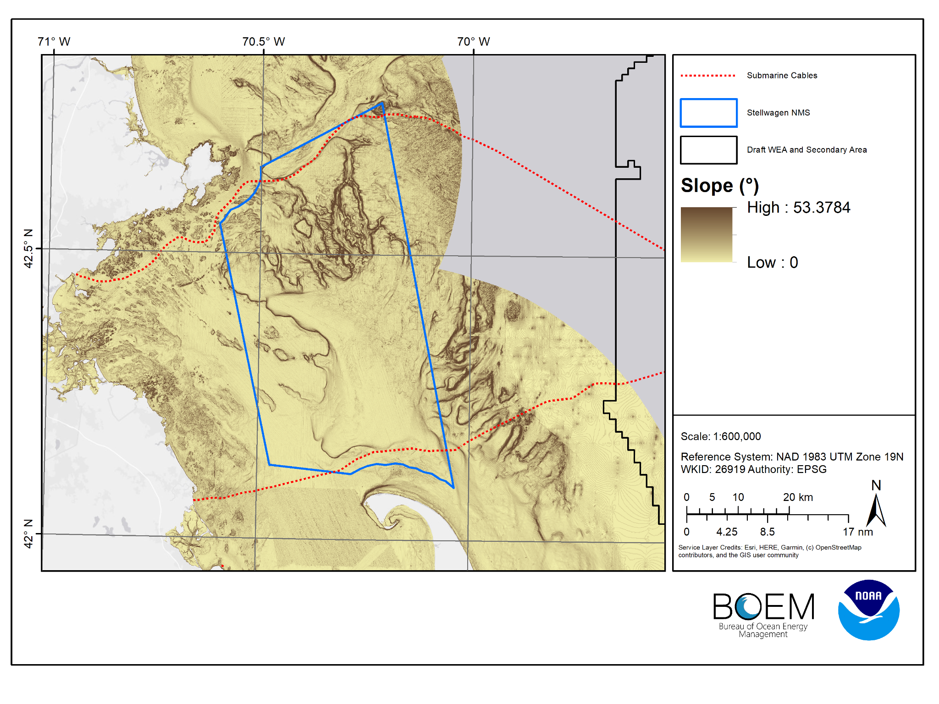
Slope Data

Slide 8
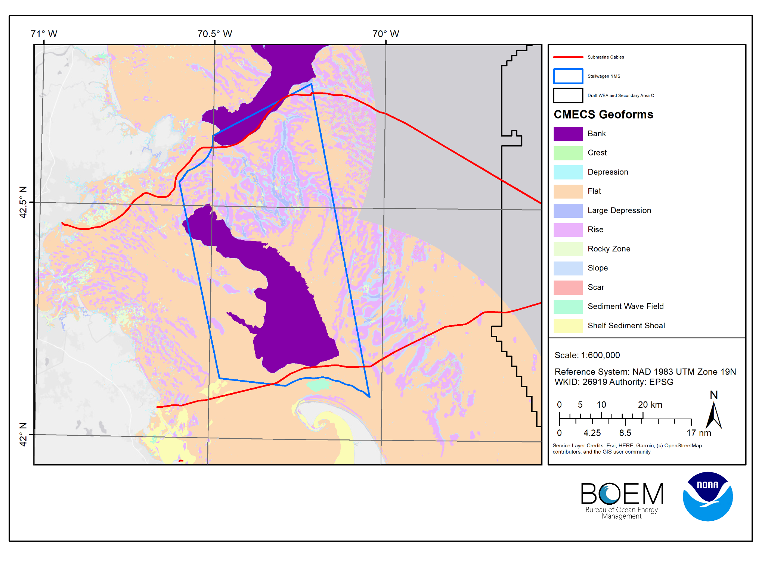
CMECS Geoforms
Existing Submarine Cables overlaid with CMECS Geoforms

Slide 9
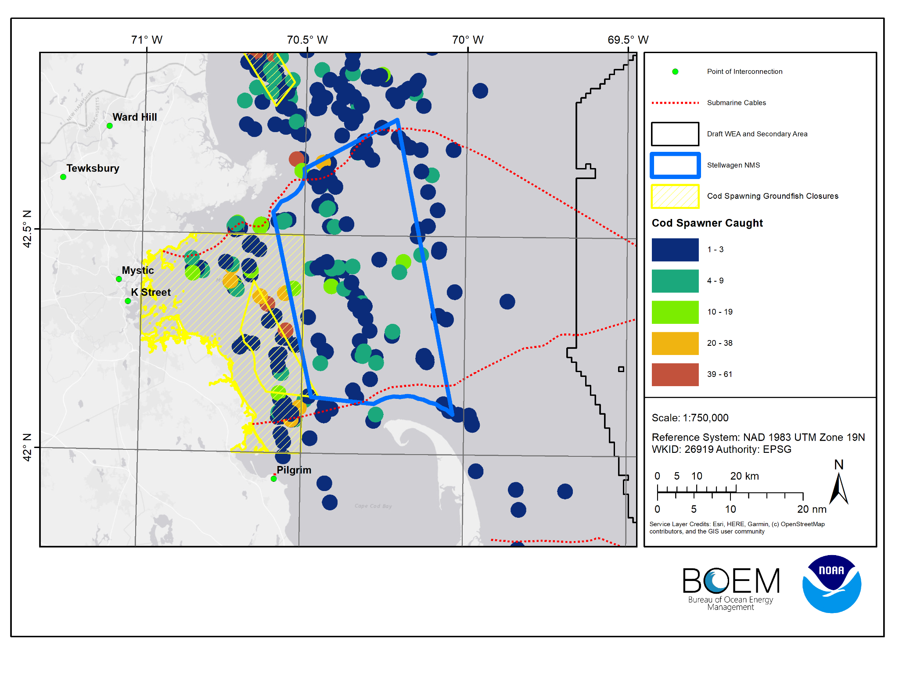
Cod Industry Based Survey
Number of Spawning cod caught, with 2-km setback distance around center of survey transect

Slide 10
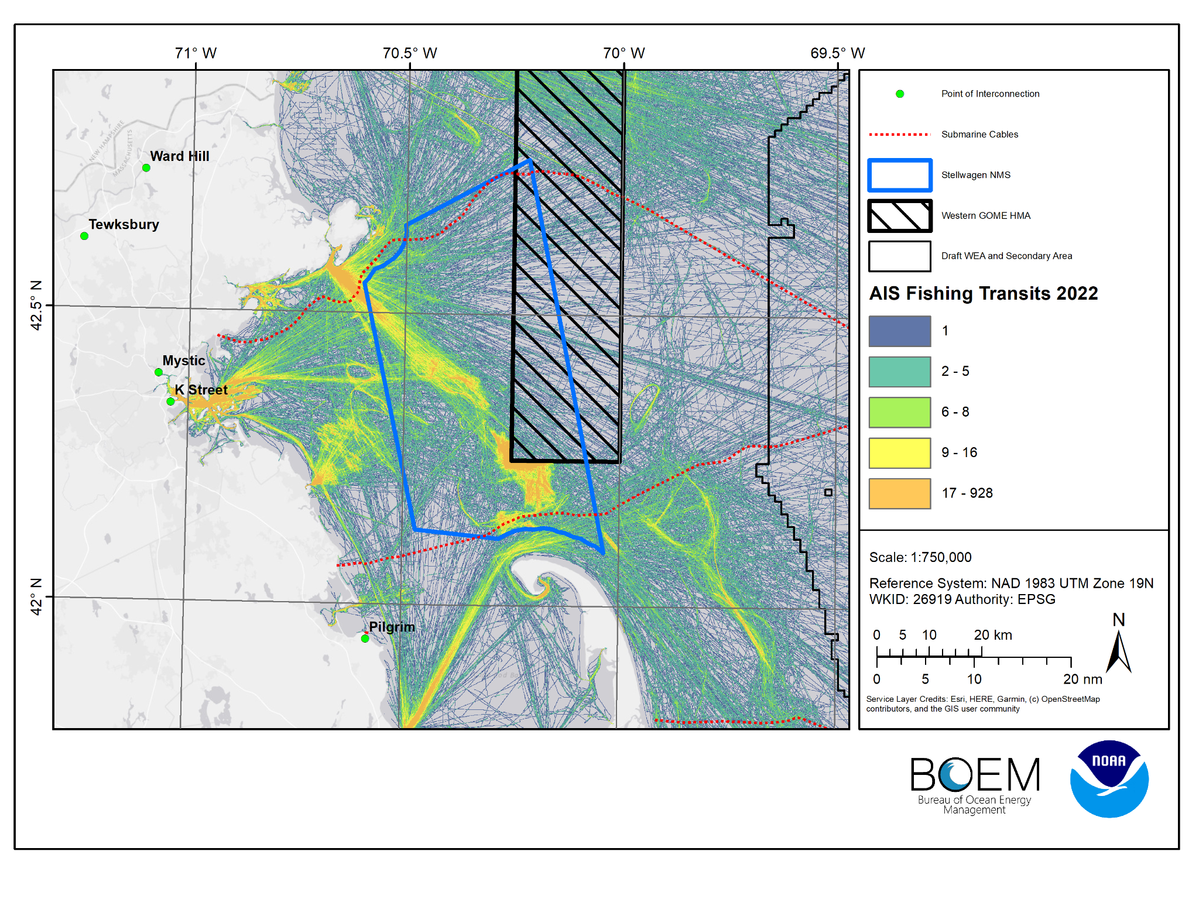
Other Considerations
Fishing Activity
Other Closures
etc.

Slide 11
Stellwagen NMS Data
Data recommended to be used by Stellwagen NMS?
Other data considerations?
Any insight into relevant sanctuary rules from the Code of Federal Regulations: https://www.ecfr.gov/current/title-15/subtitle-B/chapter-IX/subchapter-B/part-922#sp15.3.922.n

Slide 12
Cable Routing Modeling Process
Define Area of Interest
Start and end point/s
Spatial extent (study area)
Final Suitability Raster
Create Optimal Path/s
Distance accumulation
Optimal Path as a Line
Evaluate & Sort Data
Determine constraints
Characterize Path/s
Compare key features
Transform Data
Determine setbacks
Define values
Create Path Corridor
Minimum width of 1 km
Constraints Raster
Suitability Raster
Products
Final Suitability Raster
Optimal Path
Corridor for Path
Notes:
The modeling process is broken down into three main products/deliverables: the final cable suitability model, the optimal path for the route, and the corridor for the cable route.

Slide 13
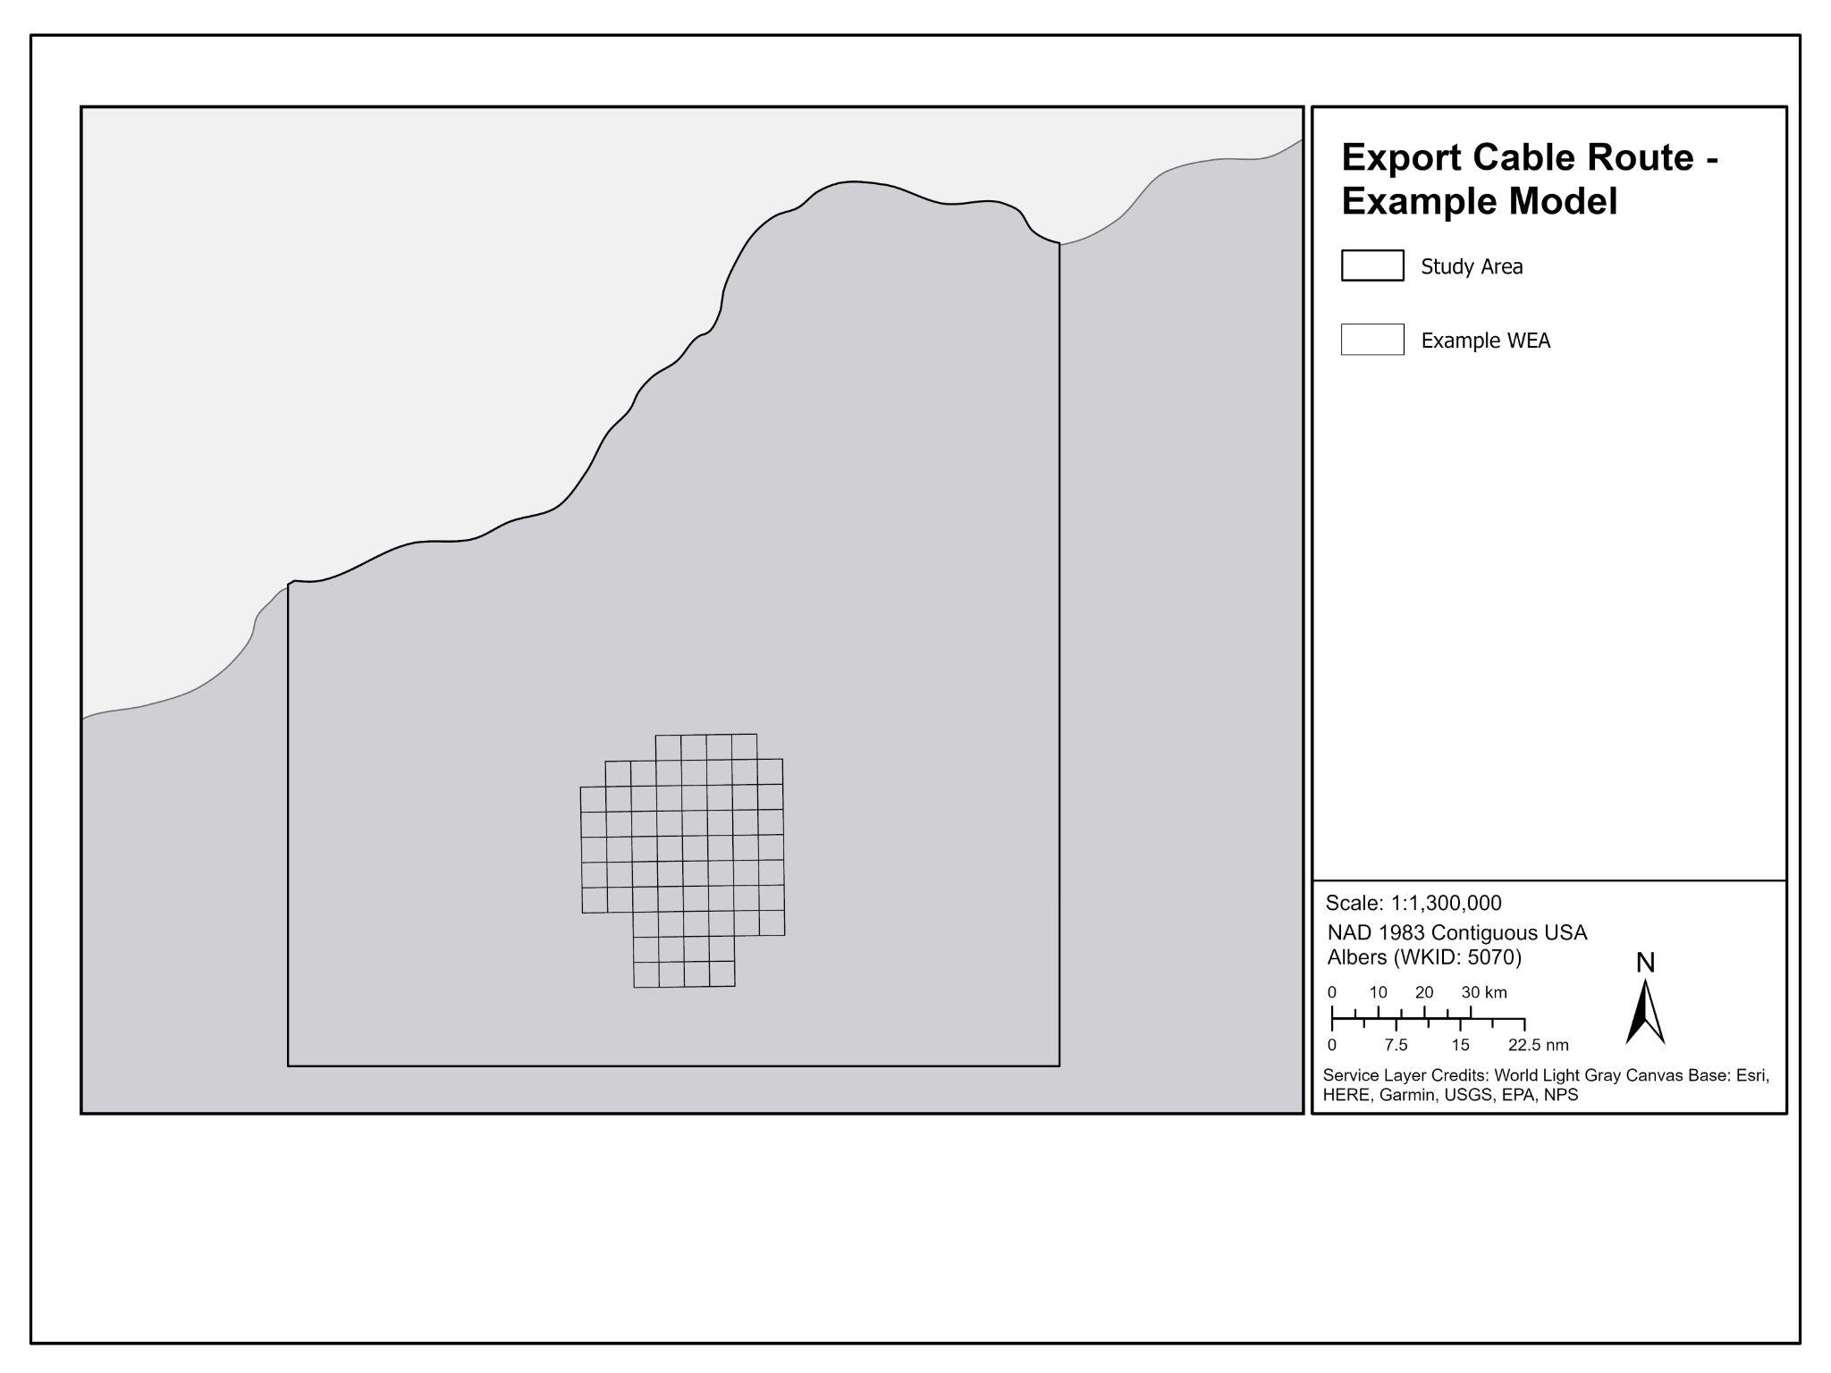
Study Area
Example
Notes:
First, the study area is created encompassing the identified lease area and extending to the coastline. This extent can be informed based on the furthest feasible Points of Interconnection / landfall points

Slide 14
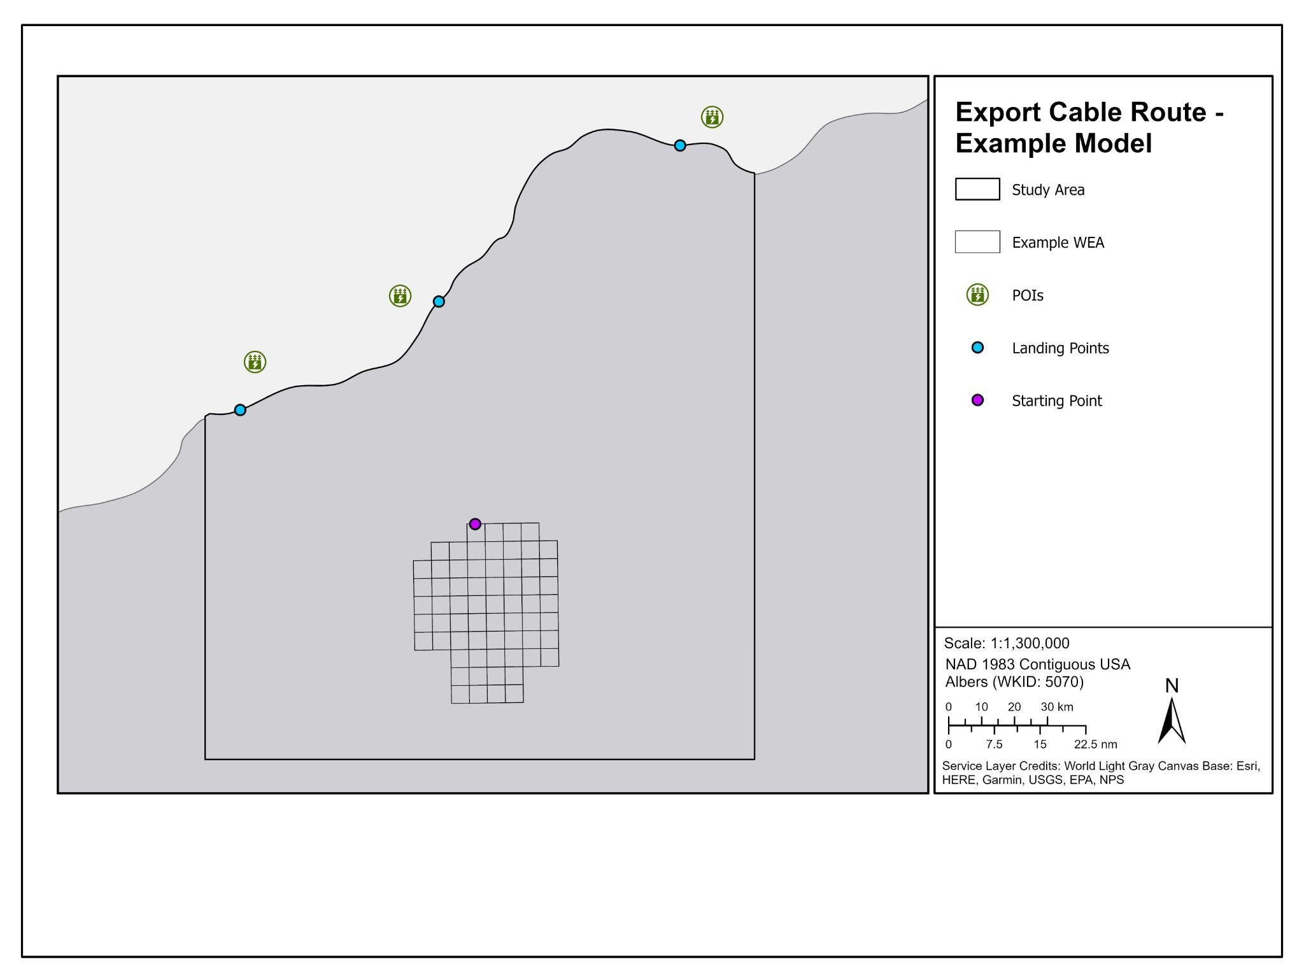
Starting and Landing Points
Example
Notes:
Second, landing points are chosen (based on location of proposed Points of Interconnection on land) and a starting point is chosen along the perimeter of the WEA.
Subsequent vetting of POIs and landfall feasibility will be needed by stakeholders, lessees and state entities
The bulk of our model will be what I explain in the next slides consisting of an overall cable suitability model of the study area
Both starting and landing points can be updated and the model can be re-ran to include different points as more information becomes available.

Slide 15
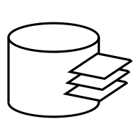

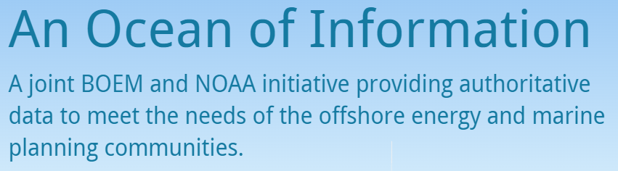

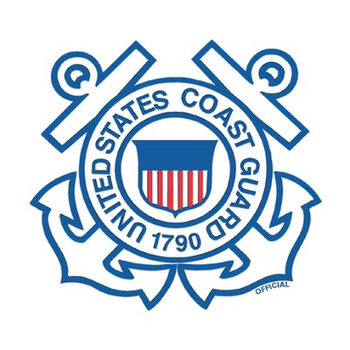




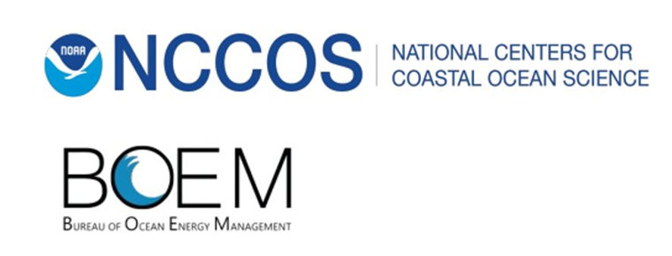
Data Inventory
Gulf of Maine MSP Database
Data Category | Number of Data Layers
National Security | 15
Natural & Cultural Resources | 147
Industry & Operations | 64
Fisheries | 148
Logistics & Economics | 15
Metocean | 36
Boundaries | 38
TOTAL | 463
Collect additional data from state/local engagement including state waters and certain land-based data
Notes:
The starting basis for our data inventory is our Gulf of Maine MSP Database, which includes 463 data layers from different sectors. We will need to collect additional data from state/local engagement including state waters and certain land-based data.
So this data inventory will be developed and updated as outreach and engagement continues with stakeholders.

Slide 16
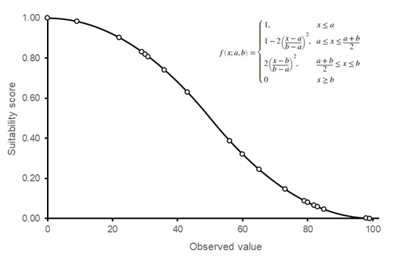
Data Transformation
Certain data layers are given setbacks (e.g., artificial reefs, fish havens, shipping lanes, pipelines)
All cost layers are assigned a value from 0.01 to 1 (0.01 = high suitability, 1 = low suitability)
Categorical Data
Continuous Data
Data | Value
Habitat Area of Particular Concern | 0.8
Oil and Gas Pipelines (500 m buffer) | 0.75
Fish Havens | 0.3
Lightering Zones | 0.5
Not Carbon Capture Areas | 0.5
Example
Fishing data
Vessel traffic data
Notes:
There are two main types of data transformation for our modeling process:
(1) certain data layers are given setbacks from their current locations (such as artificial reefs, fish havens, shipping lanes) to provide a protective distance between these layers and cables; and
(2) all data layers are either considered a constraint (and completely removed from the study area - e.g., no-go zone) or a cost layer that will be considered in the overall suitability raster.
Each layer for the suitability raster is assigned a value from 0.01 to 1 (0.01 = high suitability, 1 = low suitability).
Categorical data include layers such as as structures (oil and gas pipelines) and defined areas (lightering zones, fish havens). These are given a fixed value on a scale from 0.01 to 1 (these static values are determined from expert opinion/stakeholder engagement).
Continuous data include layers that can cover the entire study area such as AIS vessel traffic, slope, depth. These data are re-scaled from 0-1 using different functions depending on the data (e.g., S-shaped membership function, linear function).

Slide 17
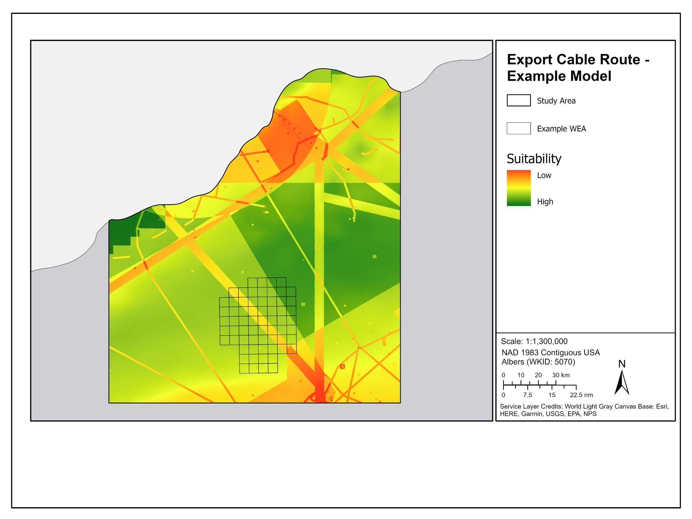
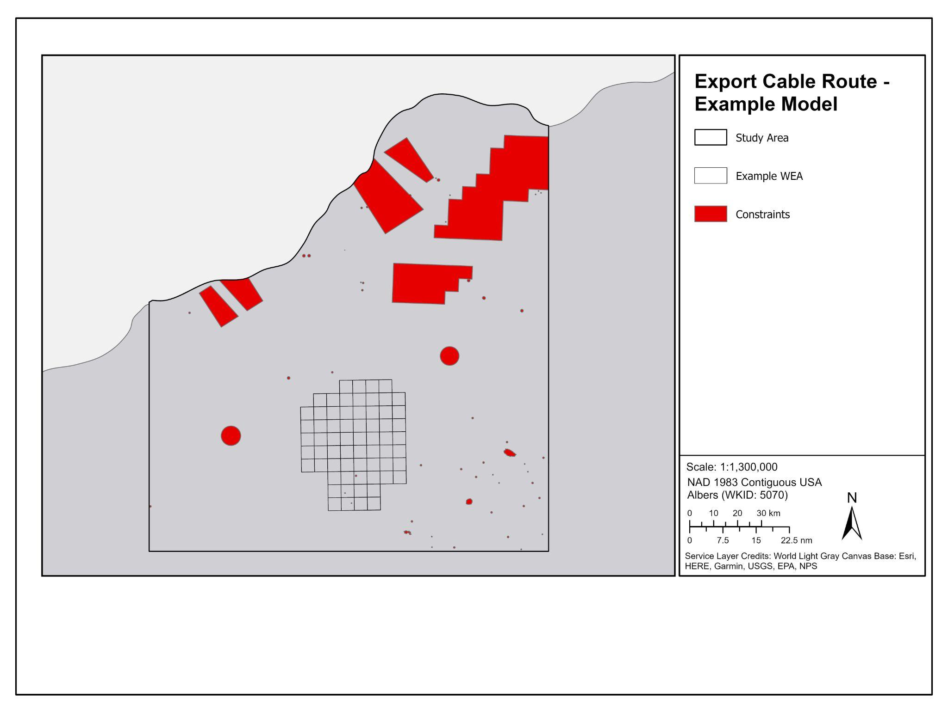
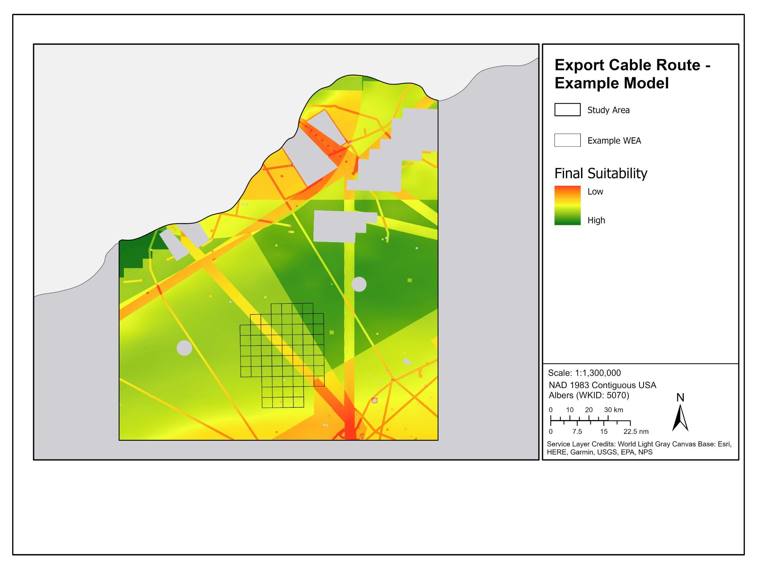
Suitability Modeling
Example
Example
Example
SUITABILITY RASTER
CONSTRAINTS RASTER
FINAL SUITABILITY RASTER
Notes:
All of the data layers considered are either categorized as a constraint or a cost. All constraint data are compiled into one raster. All cost layers are given a value, transformed accordingly, and then combined into a separate raster.
The final step is then to remove the constraints raster (area) from the suitability raster to create the final suitability raster.

Slide 18
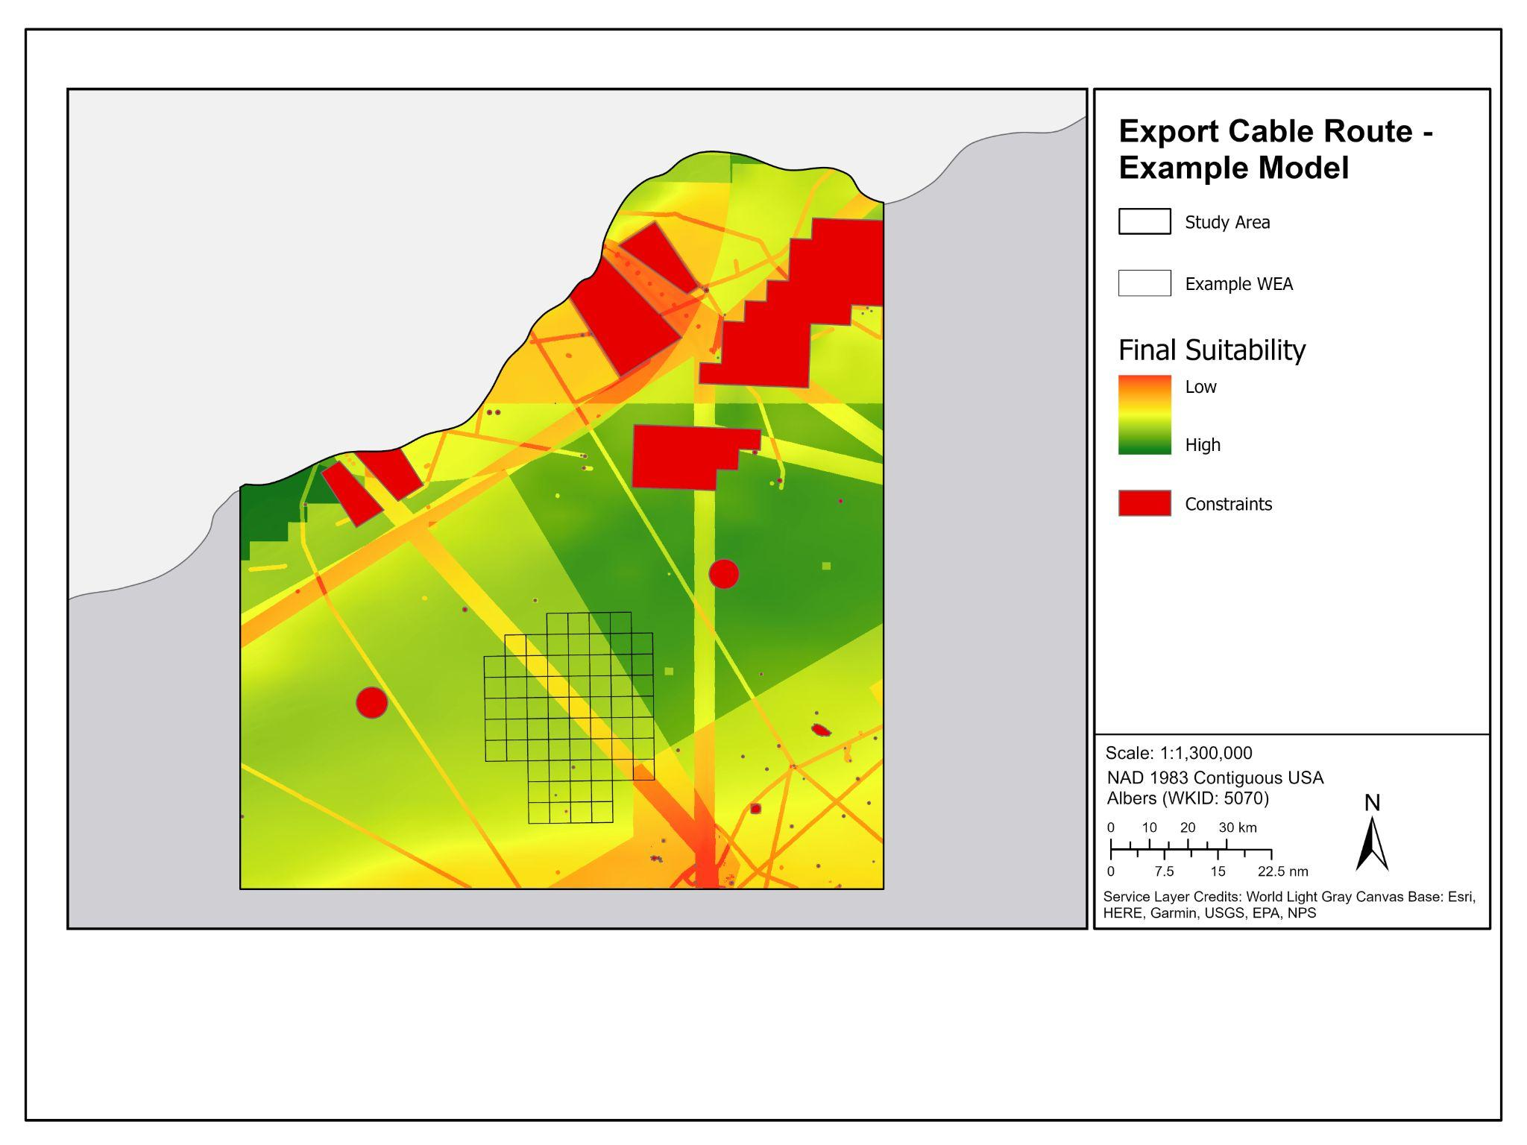
Final
Suitability
Example
Notes:
This results in our first product, which is the final suitability raster that shows areas of greater suitability for cable routing.
The next step in our modeling process is to use this suitability raster to create optimal paths from the starting points to each potential landing area. These paths are created using a distance accumulation raster, which calculates the accumulated distance for each cell in the study area to the determined starting points, incorporating the suitability raster into the distance accumulation calculation.

Slide 19
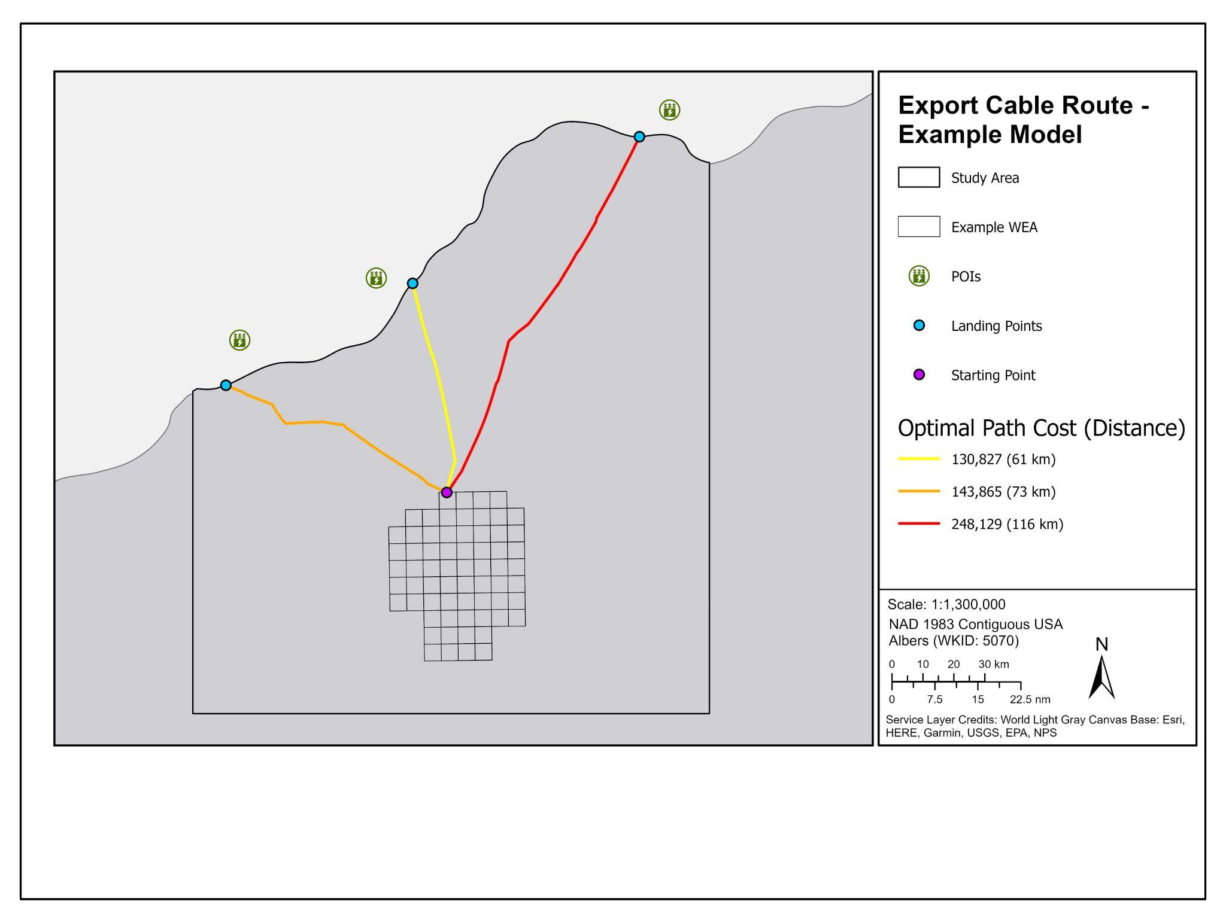
Optimal Paths from One
Starting Point
Example
Notes:
Our second product is the optimal paths from each landing point to the starting location within the WEA, and each path has a cost and length associated with it. This “cost” is not monetary, but rather the accumulation of the values of all suitability data layers throughout the cable’s path (so a path with a higher “cost” likely traverses through more conflicting areas). In this example, the yellow middle path has both the lowest “cost” and the shortest distance from the WEA to land.
It may not be possible to construct a cable route in the exact path of this line. Therefore, instead of limiting our results to a narrow line, it is more useful to provide a wider corridor (at least 1 km wide) where it would be most suitable to lay a cable while avoiding constrained areas.

Slide 20
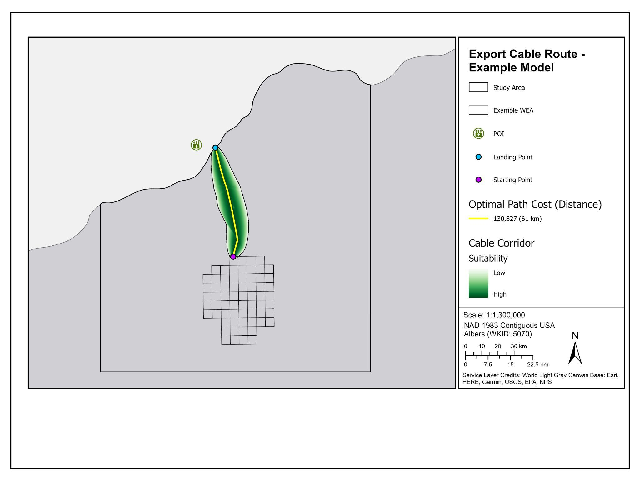
Optimal Path
with Corridor
Example
Notes:
Therefore, our third product is the corridor surrounding the optimal path that is at least 1 km wide. This area is determined by encompassing all possible paths that are less than the specified accumulative “cost” threshold.

Slide 21

Optimal Paths from Two Starting Points
Example
Notes:
It is important to determine the specific starting and landing points, as they heavily influence the location of the optimal path and corridor. For example, by creating a second starting point towards the left side of the WEA, the most optimal path now leads to the left-most landfall point.

Slide 22
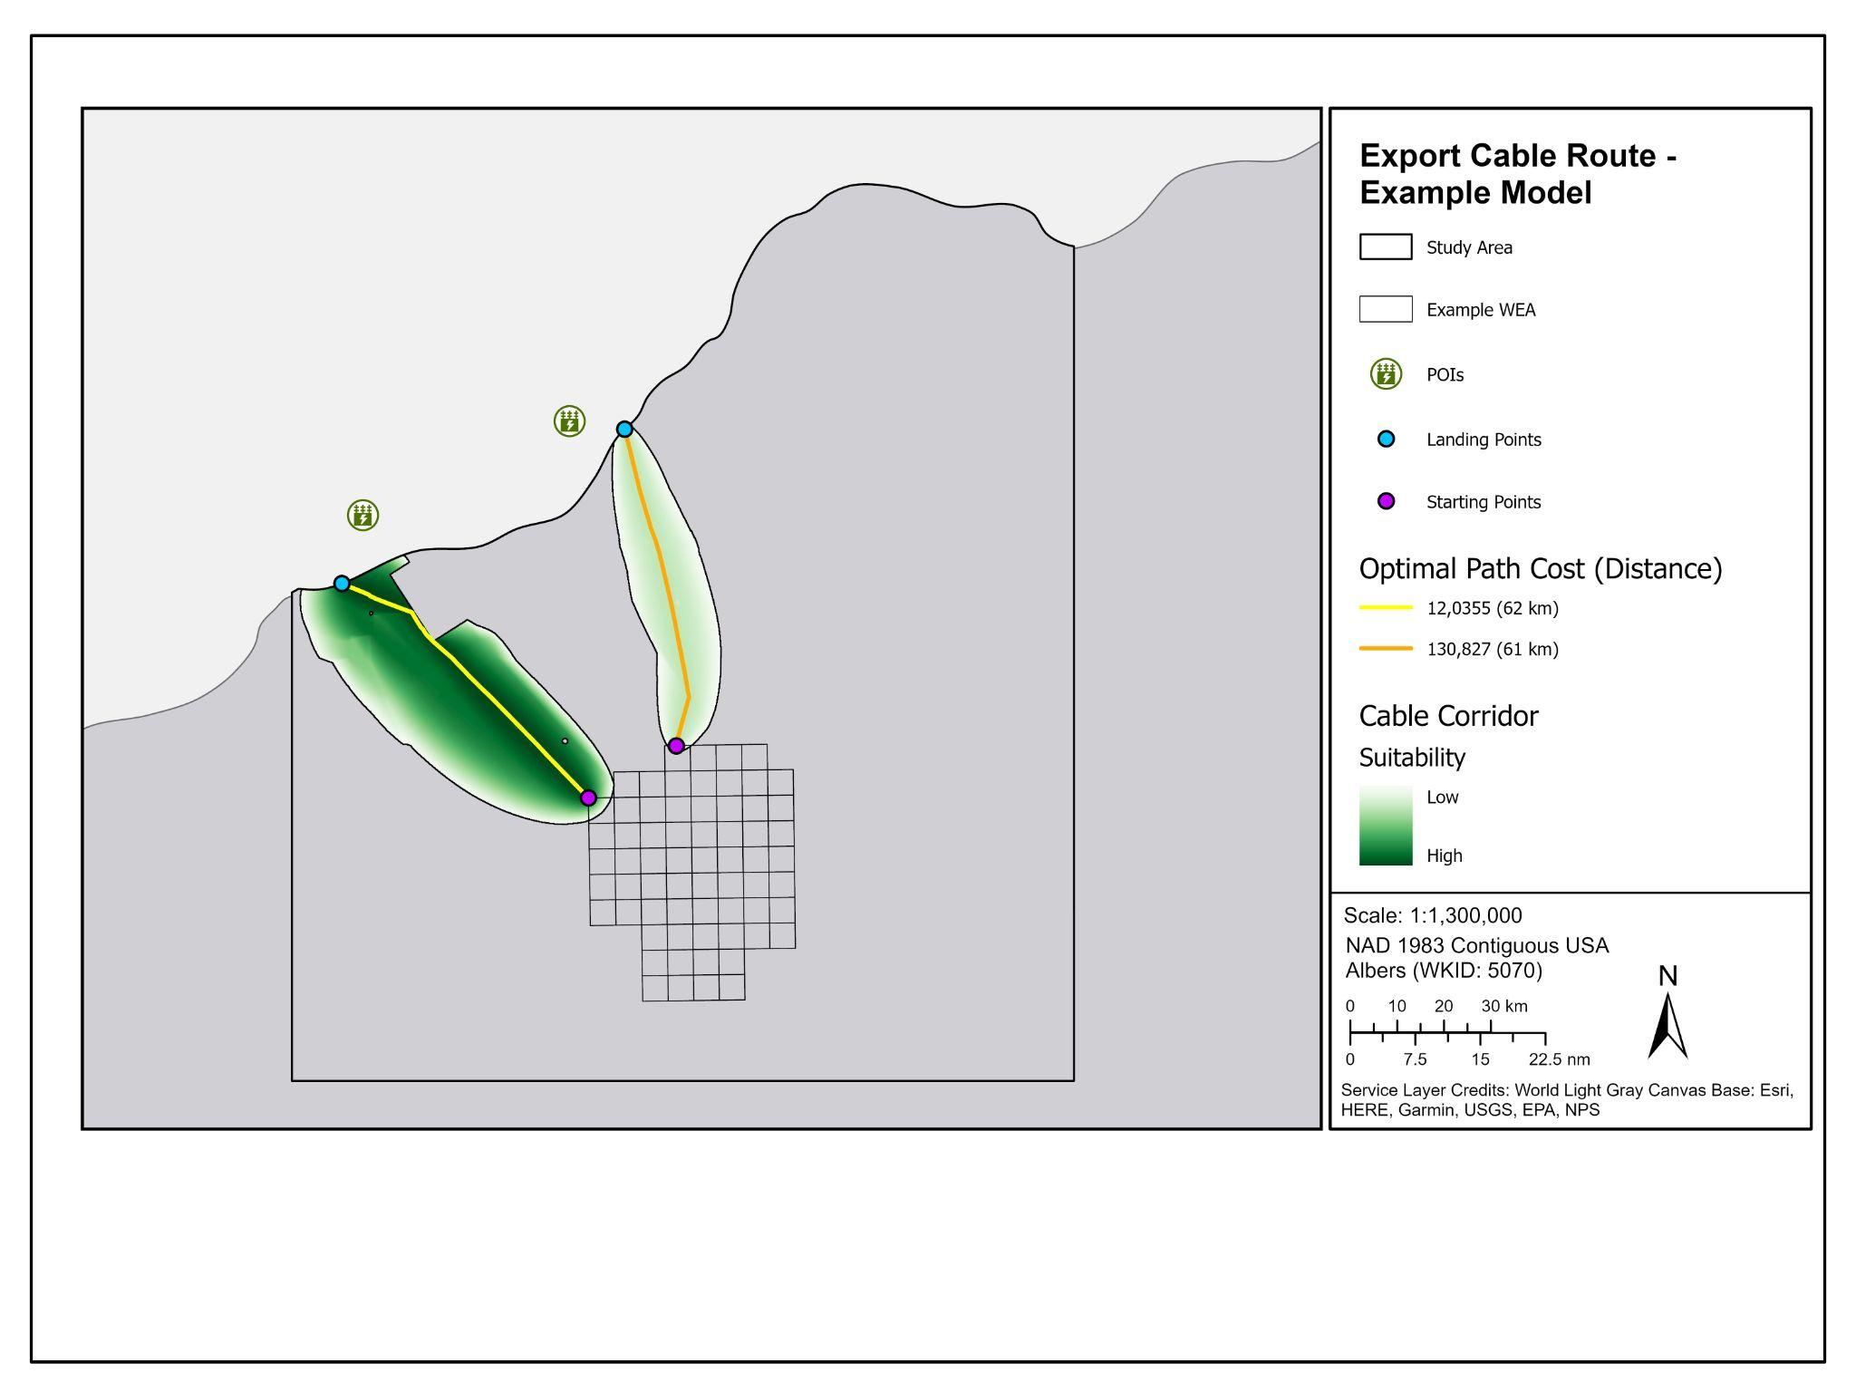
Optimal Paths
with Corridor
Example
Notes:
When looking at the corridor, adding another starting point resulted in two potential pathways from the WEA to land (with the leftmost path appearing in a darker shade and, therefore, being the most suitable for the export cable).
And this speaks to the importance of public outreach and stakeholder engagement to create the most comprehensive model for the export cable pathways.
There may be additional data layers that can be obtained from state/local agencies
Consult additional experts for decisions on layer setbacks and values for suitability layers
Important to determine the positioning of both landing points and starting points in order to better inform the final corridor.

Slide 23
Discussion
Are there any “No go” areas? (CMECS features - Bank, fish spawning grounds, sensitive habitats, shipwrecks, etc.)
Are there areas that would be ecological better than others?
Should multiple cable routes be identified? If so, how many?

Slide 24
Next Steps
Stellwagen NMS Person or Persons? (To be included in future emails, modeling/methods meetings, etc.)
NCCOS will coordinate with BOEM on timelines, planned cable routing work
Continue to gather data sets for modeling (State waters, etc.) (Ongoing)
Stakeholder meetings for cable routing (TBD)

